Slide 1
AlertMinds
Real-time Fatigue Detection and Study Enhancement
Team: 402 Payment Required
Theme: EdTech

Slide 2
402 Payment Required: Team members
Kanishk Kartik – Fresher (B.Tech CSE-AIML)
Vishwajith P – Fresher (B.Tech CSE- IS)
Akshath Rajkumar – Fresher (B.Tech CSE-AIML)

Slide 3
Problem statement
According to a study conducted by the National Library of Medicine, 47.8%, experience daytime sleepiness and 73.4% get distracted while studying or working.
This tendency to doze off during productive hours can significantly impede study flow, potentially leading to more significant challenges.
Recognizing this issue, 402 Payment Required has devised an innovative solution employing eye-movement detection technology and advanced neural networks to increase productivity during studying or working hours.

Slide 4
Proposed Solution
Develop an adaptive timetable system that utilizes historical productivity data and advanced AI algorithms to optimize study sessions, considering availability constraints and generating personalized schedules.
Employing cutting-edge neural networks like CNN and DNN, our system monitors eye movements in real-time to detect signs of drowsiness or phone distraction, facilitating accurate assessments of concentration levels. This enables timely interventions during study sessions, ensuring optimal focus and productivity.

Slide 5
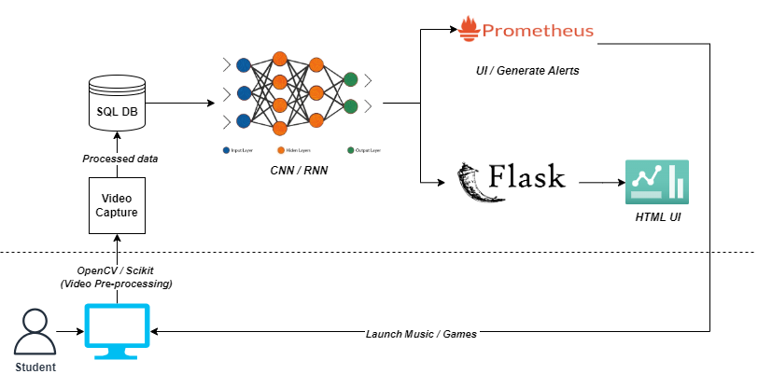
Data flow diagram

Slide 6



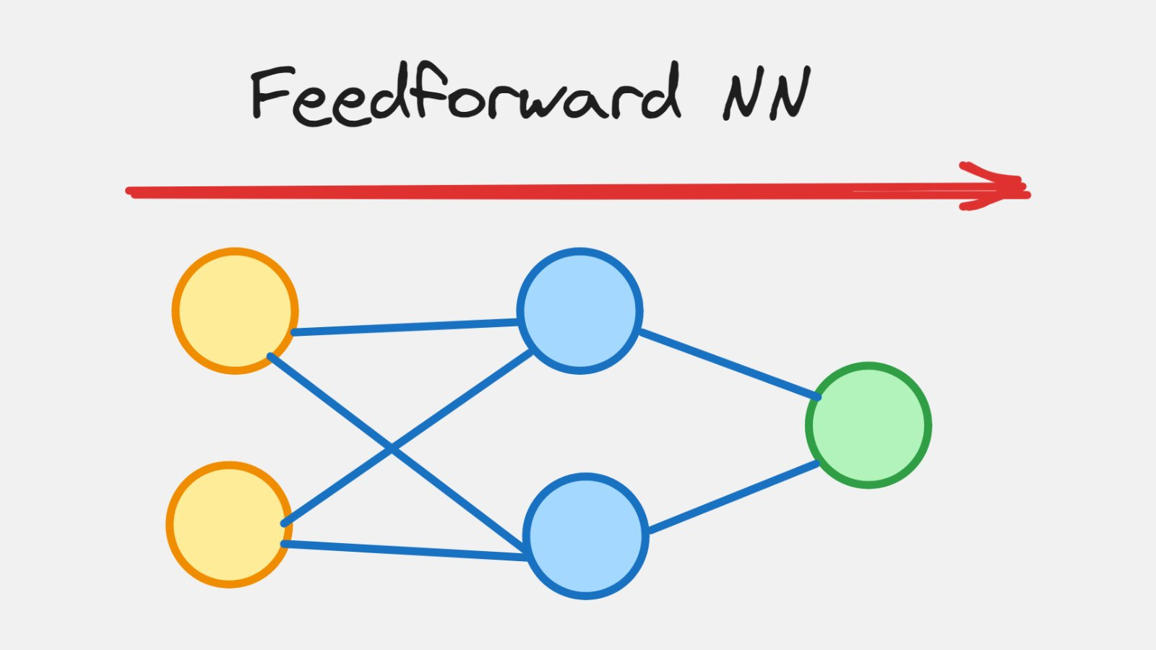


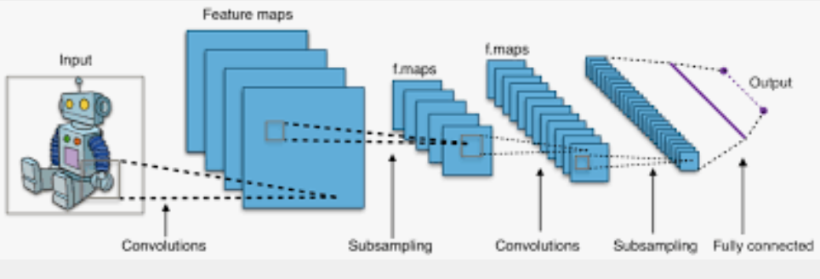
Tech stack

Slide 7
Potential impact
Productivity Enhancement
Our system helps students stay focused by detecting and addressing fatigue, leading to better learning outcomes. It also assists in managing study time effectively, aligning with peak productivity hours.
Health and Well-being
Promoting students' well-being by encouraging breaks, offering engaging mini-games, and optimizing study hours based on individual activity patterns fosters healthy study habits.
Personalized Learning Experience
The AI-generated timetable, using historical data, offers a personalized learning experience tailored to individual preferences, energy levels, and study habits.
Increased Engagement and Motivation
Adding mini-games to study breaks makes them more enjoyable and motivates users to follow the system's recommendations.

Slide 8
Business model
Establishing strategic partnerships with EdTech companies to integrate our services as an add-on feature, aiming to enhance their offerings and consequently drive mutual business growth.
Introducing a pay-as-you-go subscription model tailored for students, aimed at optimizing study hours, particularly during crucial exam periods, to enhance their academic performance and overall success.

